Slide 1
Unemployment Analysis
By Kaustubha Ram P

Slide 2
Main KPIs
Unemployment Rate before Covid
By Region
By Area
By Year
Labour Participation Rate before Covid
By Region
Estimated Employment before Covid
Unemployment during Covid
By Region
By Year, Quarter, Month
Labour Participation Rate during Covid
By Region
Estimated Employment during Covid
Region wise Unemployment Rate
Region wise Employment

Slide 3
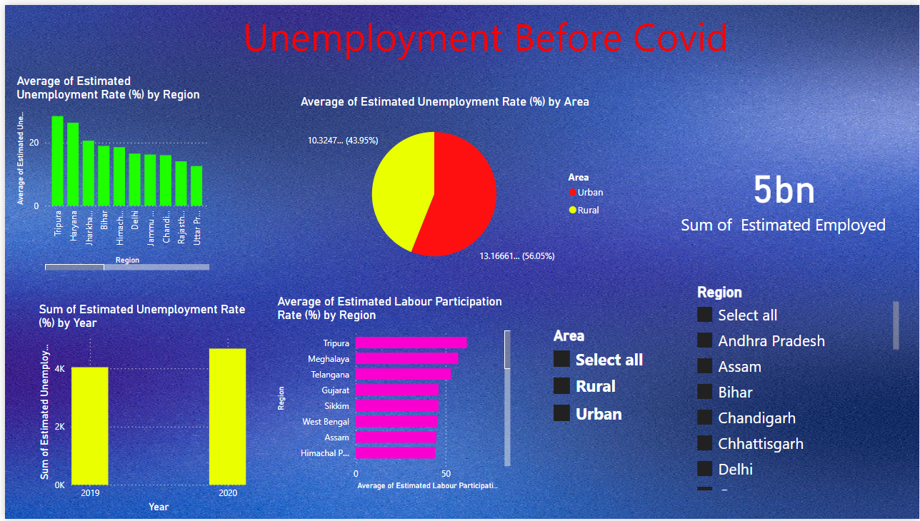
Unemployment Before Covid

Slide 4
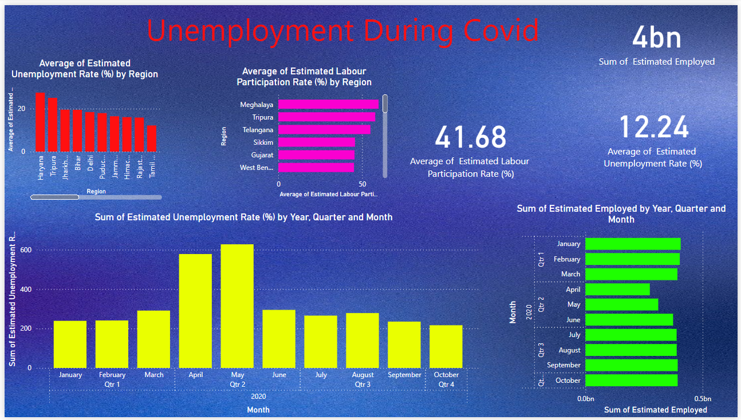
Unemployment During Covid

Slide 5
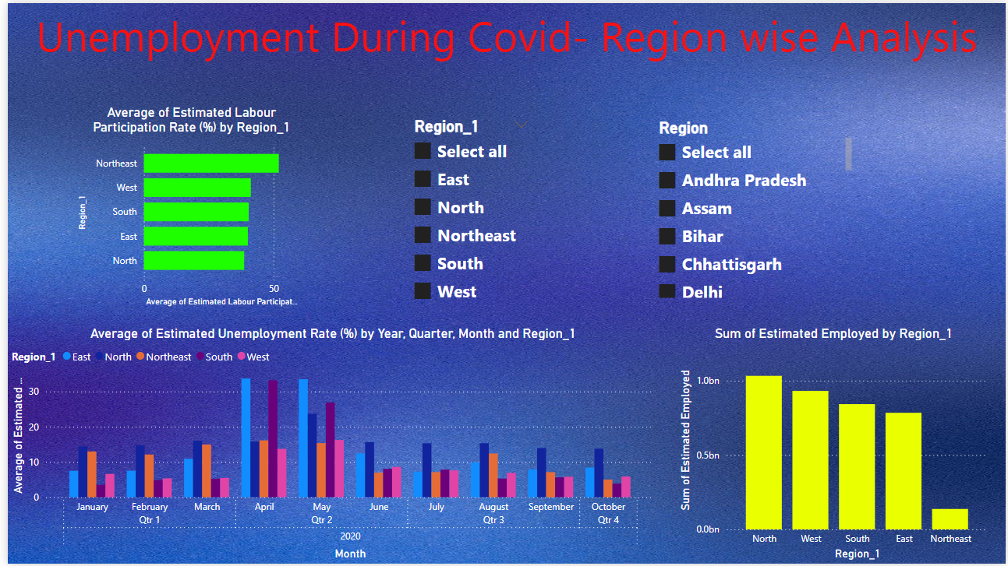
Unemployment During Covid- Region wise Analysis

Slide 6
Key Insights
Employment reduced from 5bn(pre-covid) to 4bn(during covid and unemployment rate increased
North and west regions have the highest employment
Haryana, Tripura has highest unemployment during covid
Pre Covid unemployment was higher in Urban areas
North and south regions had higher employment during the peak Covid (April- May)

Slide 7
Thank You

